Slide 1







Part 1:
MLBB Drafting Data Input Interface
Amirul Ikhwan Faizi

Slide 2
Part 1:
Input Interface
Amirul Ikhwan Faizi
2

Slide 3
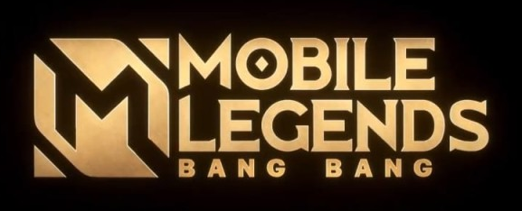





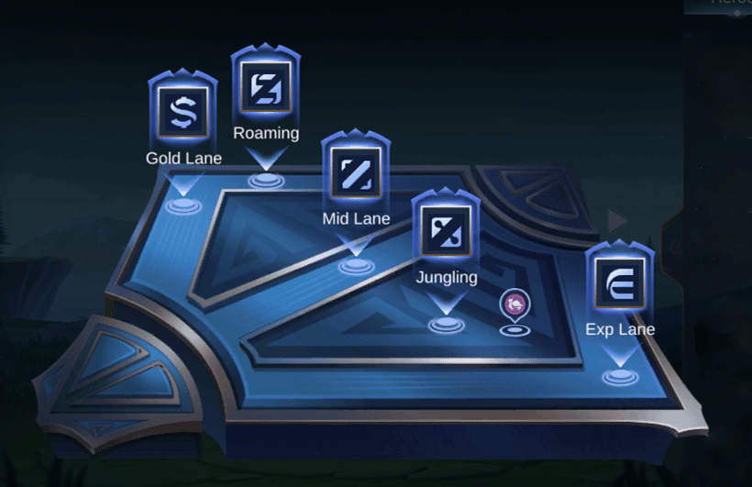
Part 1: Creating MLBB Drafting Data Interface
Lately, I have been following on one of the game in esports industry which is MOBA MLBB (Mobile Legends Bang Bang).
MOBA stands for Multiplayer Online Battle Arena. It involves two teams of five players each competing to destroy the opposing team’s base while defending their own.
Each players control unique heroes with specific roles, abilities, and engage in strategic combat, teamwork, objective control across a map divided into lanes.
Amirul Ikhwan Faizi
3

Slide 4
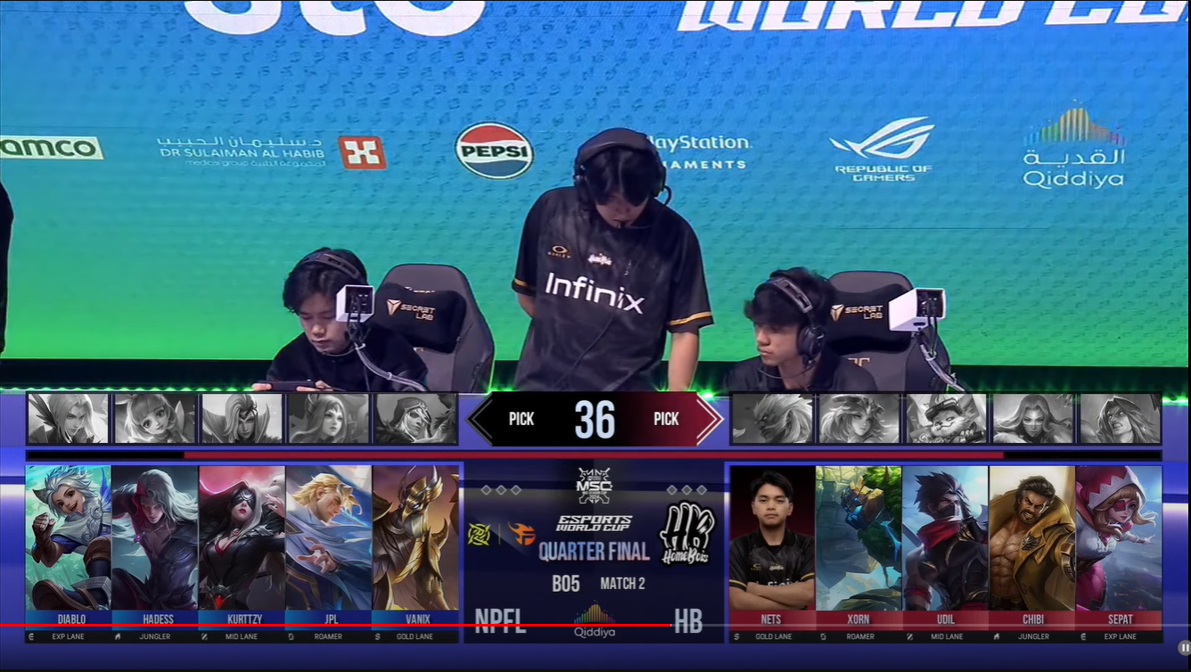
Part 1: Creating MLBB Drafting Data Interface
Before the match start, both teams will do banning and picking of heroes. This is called Drafting Phase. A team will ban heroes that they do not want enemy to use and pick heroes that they will use in game to fight enemy. The drafting phase is done following the sequences as illustrated in the next slides.
I curious on how both teams do the drafting. I wonder on its heroes and roles pattern during drafting phase. To understand the draft, I must have a look on this pattern during draft selection for not only one match, but more and more matches.
Blue Team 2nd Ban
Blue Team 4th Ban
Red Team 4th Ban
Red Team 2nd Ban
Blue Team 1st Ban
Blue Team 3rd Ban
Blue Team 5th Ban
Red Team 5th Ban
Red Team 3rd Ban
Red Team 1st Ban
Blue Team 1st Pick
Blue Team 3rd Pick
Blue Team 5th Pick
Red Team 5th Pick
Red Team 3rd Pick
Red Team 1st Pick
Blue Team 2nd Pick
Blue Team 4th Pick
Red Team 4th Pick
Red Team 2nd Pick
Amirul Ikhwan Faizi
4

Slide 5
Part 1: Creating MLBB Drafting Data Interface
Drafting Phase: 1st Phase Hero Banning
Blue Team 1st Ban
Red Team 1st Ban
Blue Team 2nd Ban
Red Team 2nd Ban
Blue Team 3rd Ban
Red Team 3rd Ban
Amirul Ikhwan Faizi
5

Slide 6
Part 1: Creating MLBB Drafting Data Interface
Drafting Phase: 1st Phase Hero Picking
Blue Team 1st Pick
Red Team 1st Pick
Red Team 2nd Pick
Blue Team 2nd Pick
Blue Team 3rd Pick
Red Team 3rd Pick
Amirul Ikhwan Faizi
6

Slide 7
Part 1: Creating MLBB Drafting Data Interface
Drafting Phase: 2nd Phase Hero Banning
Red Team 4th Ban
Blue Team 4th Ban
Red Team 5th Ban
Blue Team 5th Ban
Amirul Ikhwan Faizi
7

Slide 8
Part 1: Creating MLBB Drafting Data Interface
Drafting Phase: 2nd Phase Hero Picking
Red Team 4th Pick
Blue Team 4th Pick
Blue Team 5th Pick
Red Team 5th Pick
Amirul Ikhwan Faizi
8

Slide 9
Part 1: Creating MLBB Drafting Data Interface
In order to see the pattern of drafting, I should start gather data of this MLBB draft through MLBB tournament matches. The data then should be documented and analysed later. I can open Microsoft Excel, make a table, put necessary headers and fill in the rows of data manually.
However, I decide to ask ChatGPT if my idea to have an interface to input MLBB drafting data can come into reality. I started with simple drawing by using PowerPoint on how I want the interface looks like (Figure 1). I bring the drawing and use ChatGPT tool to ask if I may have initial HTML code that can provide result that similar to my drawing.
I do this kind of thing because of interest and curiosity. Interest to create an input interface and curiosity in knowing MLBB drafting data pattern.
I know that I do not do all the coding itself. Anyhow, I do take this initiative with those available tools to enable this kind of project.
Besides, with some basic knowledge about some programming languages I learned from online courses and program, that also help me to understand certain part of code. Knowing how it works and how to solve if any issues arise.
Amirul Ikhwan Faizi
9

Slide 10
Part 1: Creating MLBB Drafting Data Interface
Below is the simple drawing on how I want the interface looks like. (Figure 1)
Blue Team
Match ID
Red Team
Input Blue Team Name
Input Match ID
Input Red Team Name
Input Blue Team 1st Ban
Input Blue Team 2nd Ban
Input Blue Team 3rd Ban
Input Blue Team 4th Ban
Input Blue Team 5th Ban
Input Red Team 5th Ban
Input Red Team 4th Ban
Input Red Team 3rd Ban
Input Red Team 2nd Ban
Input Red Team 1st Ban
Hero Picture
Blue Team
1st Pick
Hero Picture
Blue Team
2nd Pick
Hero Picture
Blue Team
3rd Pick
Hero Picture
Blue Team
4th Pick
Hero Picture
Blue Team
5th Pick
Hero Picture
Red Team
5th Pick
Hero Picture
Red Team
4th Pick
Hero Picture
Red Team
3rd Pick
Hero Picture
Red Team
2nd Pick
Hero Picture
Red Team
1st Pick
Input Blue Team 1st Pick
Input Blue Team 2nd Pick
Input Blue Team 3rd Pick
Input Blue Team 4th Pick
Input Blue Team 5th Pick
Input Red Team 5th Pick
Input Red Team 4th Pick
Input Red Team 3rd Pick
Input Red Team 2nd Pick
Input Red Team 1st Pick
Input Role Blue Team 1st Pick
Input Role Blue Team 2nd Pick
Input Role Blue Team 3rd Pick
Input Role Blue Team 4th Pick
Input Role Blue Team 5th Pick
Input Role Red Team 5th Pick
Input Role Red Team 4th Pick
Input Role Red Team 3rd Pick
Input Role Red Team 2nd Pick
Input Role Red Team 1st Pick
Winning Team
Input Winning Team
LOAD
Amirul Ikhwan Faizi
10

Slide 11
Part 1: Creating MLBB Drafting Data Interface
Below is the list of MLBB drafting data inputs that I want to gather from the interface and may use it for further analysis later.
MATCHID
BLUE_TEAM
RED_TEAM
BLUE_1STBAN
RED_1STBAN
BLUE_2NDBAN
RED_2NDBAN
BLUE_3RDBAN
RED_3RDBAN
BLUE_1STPICK
BLUE_1STPICK_ROLE
RED_1ST PICK
RED_1ST PICK_ROLE
RED_2NDPICK
RED_2NDPICK_ROLE
BLUE_2NDPICK
BLUE_2NDPICK_ROLE
BLUE_3RDPICK
BLUE_3RDPICK_ROLE
RED_3RDPICK
RED_3RDPICK_ROLE
RED_4THBAN
BLUE_4THBAN
RED_5THBAN
BLUE_5THBAN
RED_4THPICK
RED_4THPICK_ROLE
BLUE_4THPICK
BLUE_4THPICK_ROLE
BLUE_5THPICK
BLUE_5THPICK_ROLE
RED_5THPICK
RED_5THPICK_ROLE
WINNING_TEAM
Amirul Ikhwan Faizi
11

Slide 12
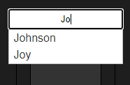
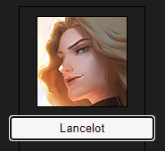
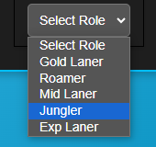
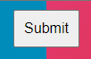
Part 1: Creating MLBB Drafting Data Interface
General Steps
Ask ChatGPT to create the interface as per drawing.
Get some initial HTML, CSS and JavaScript codes. Having the box to type the input, dropdown list of heroes selection with autocomplete feature, dropdown list of roles and images of heroes linked to the selected heroes.
Further ask to make the interface to have the functionality of inputting the data itself into an Excel file row by row. Plus, the interface will clear all inputs after click Submit button and the interface is ready for next data.
Amirul Ikhwan Faizi
12

Slide 13
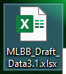
Part 1: Creating MLBB Drafting Data Interface
I use Node.js to handle the Excel file to be saved to a specific location in my desktop, can read the existing Excel file, append new data and save it back to my desktop.
Lots of errors or results not as expected over time. Keep ask in detail about how the expected results should work. Keep look back in which part of the code that may cause the issues. Try to understand the issues and solve it accordingly.
Amirul Ikhwan Faizi
13

Slide 14
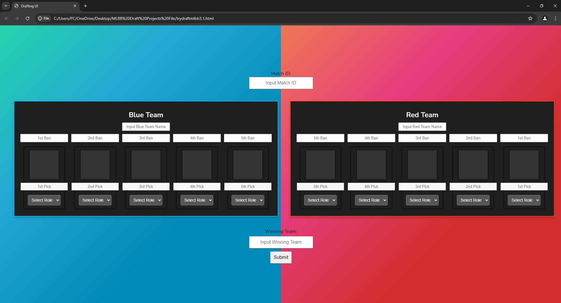
Part 1: Creating MLBB Drafting Data Interface
Result:
Amirul Ikhwan Faizi
14

Slide 15
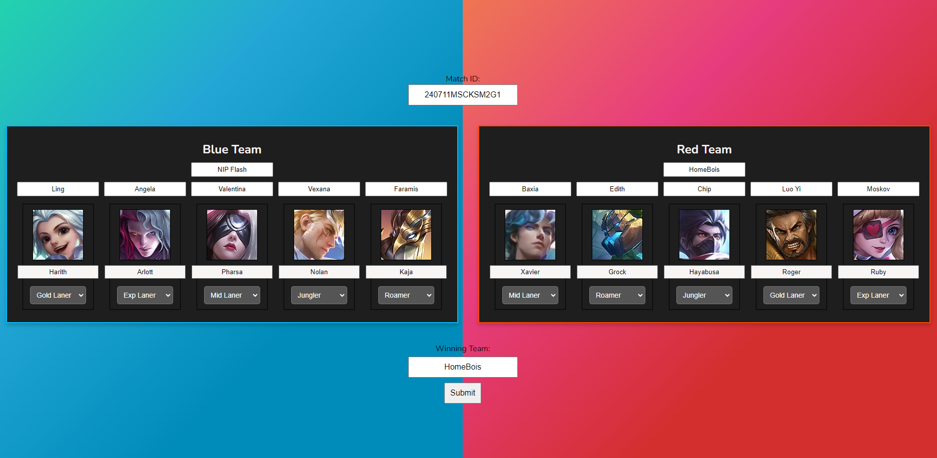
Part 1: Creating MLBB Drafting Data Interface
Blue Team 2nd Ban
Blue Team 4th Ban
Red Team 4th Ban
Red Team 2nd Ban
Blue Team 1st Ban
Blue Team 3rd Ban
Blue Team 5th Ban
Red Team 5th Ban
Red Team 3rd Ban
Red Team 1st Ban
Blue Team 1st Pick
Blue Team 3rd Pick
Blue Team 5th Pick
Red Team 5th Pick
Red Team 3rd Pick
Red Team 1st Pick
Blue Team 2nd Pick
Blue Team 4th Pick
Red Team 4th Pick
Red Team 2nd Pick
Amirul Ikhwan Faizi
15

Slide 16
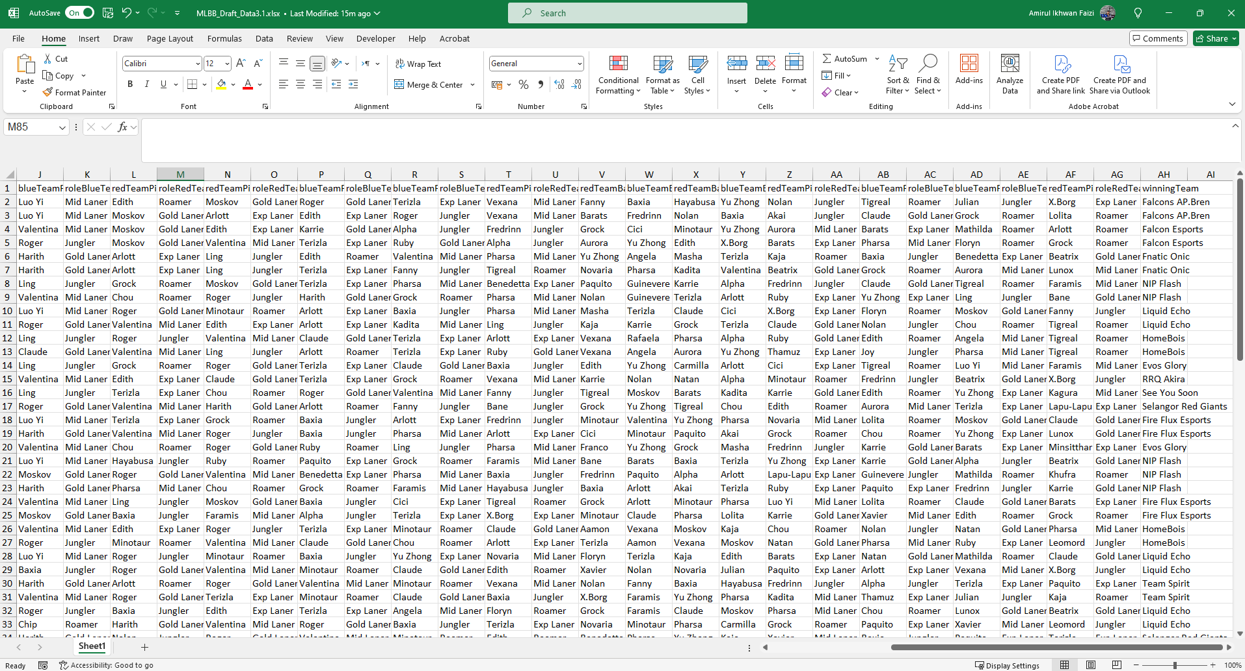

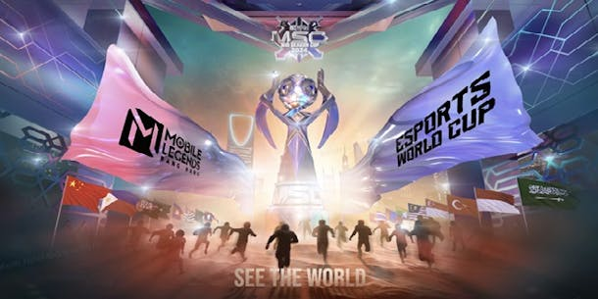
Part 1: Creating MLBB Drafting Data Interface
Result: Excel File With MLBB Drafting Data
The above MLBB data is taken from one of the main MLBB Tournament which is Mid Season Cup (MSC) 2024 at Esports World Cup (EWC). The tournament is organized at Riyadh, Saudi Arabia from 3rd July 2024 until 14th July 2024 and the data is based on MLBB game patch 1.8.92.
Amirul Ikhwan Faizi
16

Slide 17
Part 2:
Data Analysis and Data Visualization of MLBB Drafting Data
Amirul Ikhwan Faizi
17

Slide 18
Part 2: Data Analysis and Data Visualization
Blue Team 2nd Ban
Blue Team 4th Ban
Red Team 4th Ban
Red Team 2nd Ban
Blue Team 1st Ban
Blue Team 3rd Ban
Blue Team 5th Ban
Red Team 5th Ban
Red Team 3rd Ban
Red Team 1st Ban
Blue Team 1st Pick
Blue Team 3rd Pick
Blue Team 5th Pick
Red Team 5th Pick
Red Team 3rd Pick
Red Team 1st Pick
Blue Team 2nd Pick
Blue Team 4th Pick
Red Team 4th Pick
Red Team 2nd Pick
Amirul Ikhwan Faizi
18

Slide 19
Part 2: Data Analysis and Data Visualization
Firstly, let's have a look on all data inputs that have been gathered.
MATCHID:
Unique identifier for each match following YYMMDD+Tournament+Match+Game format.
BLUE_TEAM:
Team Name at the Blue side (will do the first Hero Pick in the drafting phase)
RED_TEAM:
Team Name at the Red side (will do the last Hero Pick in the drafting phase)
BLUE_1STBAN | RED_1STBAN | BLUE_2NDBAN | RED_2NDBAN | BLUE_3RDBAN | RED_3RDBAN | RED_4THBAN | BLUE_4THBAN | RED_5THBAN | BLUE_5THBAN :
Heroes that are being banned from being picked by the opponent during the drafting phase.
BLUE_1STPICK | RED_1ST PICK | RED_2NDPICK | BLUE_2NDPICK | BLUE_3RDPICK | RED_3RDPICK | RED_4THPICK | BLUE_4THPICK | BLUE_5THPICK | RED_5THPICK :
Heroes that are being picked by teams to fight in the game.
Amirul Ikhwan Faizi
19

Slide 20
Part 2: Data Analysis and Data Visualization
BLUE_1STPICK_ROLE | RED_1ST PICK_ROLE | RED_2NDPICK_ROLE | BLUE_2NDPICK_ROLE | BLUE_3RDPICK_ROLE | RED_3RDPICK_ROLE | RED_4THPICK_ROLE | BLUE_4THPICK_ROLE | BLUE_5THPICK_ROLE | RED_5THPICK_ROLE :
Specific roles of heroes in game in which are either Gold Laner, Roamer, Mid Laner, Jungler or Exp Laner.
WINNING_TEAM :
Name of the winning team.
Amirul Ikhwan Faizi
20

Slide 21
Part 2: Data Analysis and Data Visualization
Objective of analysis
Goal: Analyze the drafting data to identify trends, strategies and potential advantages based on team compositions and bans.
Specific questions?
Which heroes are most commonly banned/picked?
Are there correlations between certain picks/bans and winning outcomes?
Nature of the data
Type
Categorical (Qualitative data that can be grouped/categorized into distinct categories and cannot be measured numerically)
Team Names
Hero Picks
Hero Bans
Nominal (Categorical data that does not have any meaningful order or ranking among its categories. Purely used to label or identify different entities)
Match ID
Amirul Ikhwan Faizi
21

Slide 22


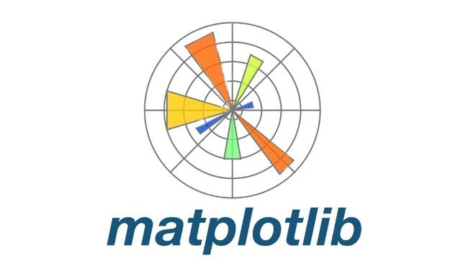
Part 2: Data Analysis and Data Visualization
Sample size
Size: 79 matches from group stages until Grandfinal.
Tools
Python Libraries
Pandas
Matplotlib
Seaborn
Amirul Ikhwan Faizi
22

Slide 23
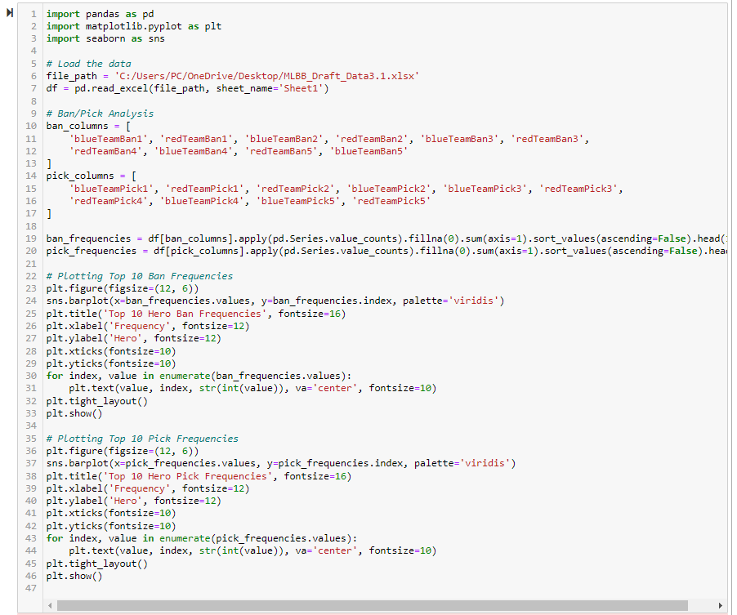
Part 2: Data Analysis and Data Visualization
Frequency Analysis: Top 10 Hero Ban
Amirul Ikhwan Faizi
23

Slide 24
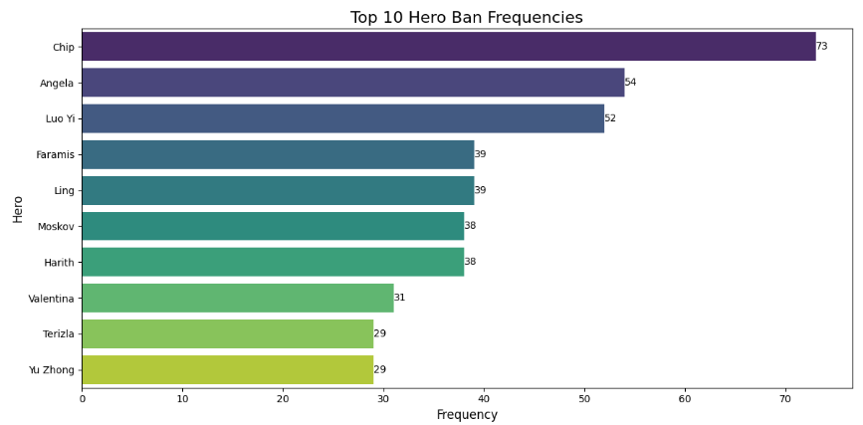
Part 2: Data Analysis and Data Visualization
Frequency Analysis: Top 10 Hero Ban
Chip is the most banned heroes because of its unique ability that can suddenly open portal anywhere around the map close to the enemy hero. This ability can cause chaos and disturb enemy plan to do any proper team fight.
Angela is the hero with her unique support abilities. She can heal allies, bind enemies with her puppet strings, and teleport to any teammate, providing crucial assistance in fights. Her versatility and impact on team dynamics make her a priority ban.
Luo Yi have powerful crowd control abilities and game-changing ultimate. She can teleport her team across the map, enabling surprise attacks or escapes. Her skills can disrupt enemy formations, making her a significant threat in strategic gameplay.
Amirul Ikhwan Faizi
24

Slide 25
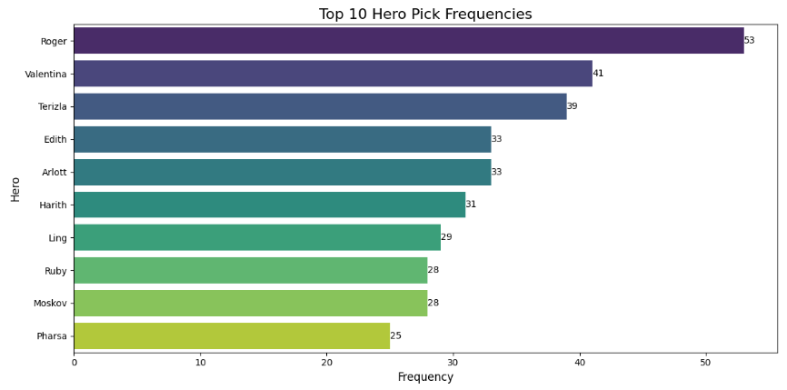
Part 2: Data Analysis and Data Visualization
Frequency Analysis: Top 10 Hero Picks
Roger is the most picked heroes because of his versatile dual forms. He can switch between a ranged marksman and a melee fighter, adapting to various combat situations. His high damage output, mobility, and lifesteal make him a formidable and flexible choice in battles.
Valentina is the hero with her unique ability to copy an enemy's ultimate skill. This versatility allows her to adapt to various situations and turn the tide of battle. Her strong burst damage and crowd control make her a valuable asset in any team composition.
Terizla have powerful area-of-effect damage and crowd control abilities. His resilience in battle and ability to initiate team fights make him a formidable frontliner. Terizla's skills can significantly disrupt enemy formations, making him a strategic choice for many teams.
Amirul Ikhwan Faizi
25

Slide 26
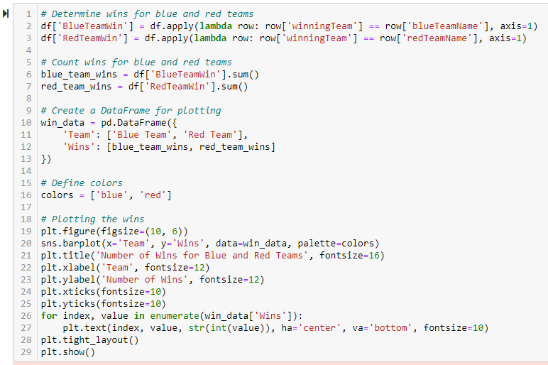
Part 2: Data Analysis and Data Visualization
Number of Team Win at Blue or Red Side
Amirul Ikhwan Faizi
26

Slide 27
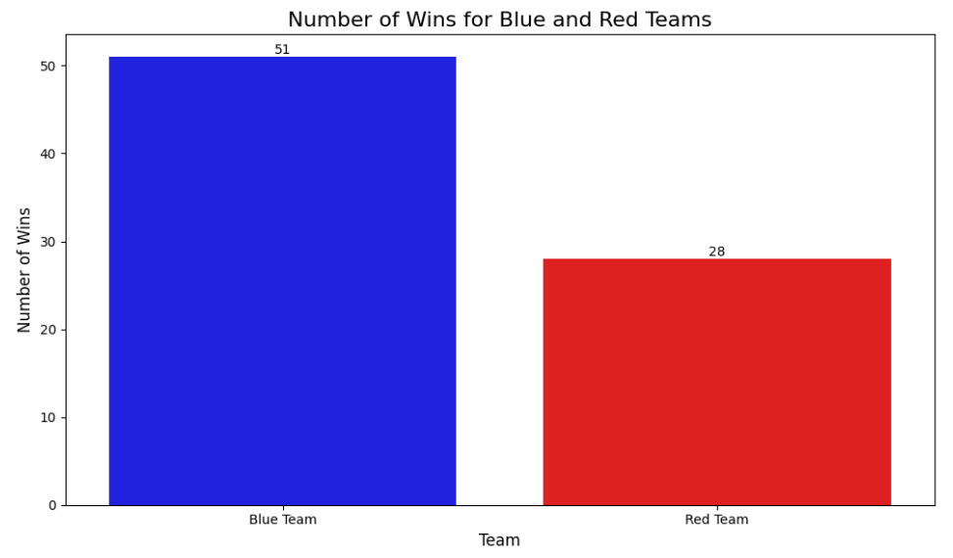
Part 2: Data Analysis and Data Visualization
Number of Team Win at Blue or Red Side
The plot illustrates the number of wins achieved by teams starting on the Blue side versus the Red side in the analyzed matches. Specifically, the Blue team (having advantage of picking first hero in the drafting phase) secured 51 victories, while the Red team (having advantage of picking last hero in the drafting phase) managed 28 wins.
Amirul Ikhwan Faizi
27

Slide 28
Part 2: Data Analysis and Data Visualization
This data indicates that teams on the Blue side have a higher win rate compared to those on the Red side. One potential insight from this observation could be that the Blue side might possess strategic advantages, such as the benefit of first pick, which could allow them to secure key heroes or better counter the opposing team's picks.
Anyhow, the situation may vary when both strong teams fight against each other where most of these teams usually having better draft preparation by the coaches, players with big hero pools and clear gameplay in which they can always turn the losing situation into a winning situation.
This disparity in win rates between the Blue and Red teams is a significant finding and suggests that the side a team starts on may influence their chances of winning. Teams and analysts could leverage this insight to refine their strategies, possibly focusing on maximizing the advantages or mitigating the disadvantages associated with starting on either side.
Amirul Ikhwan Faizi
28

Slide 29
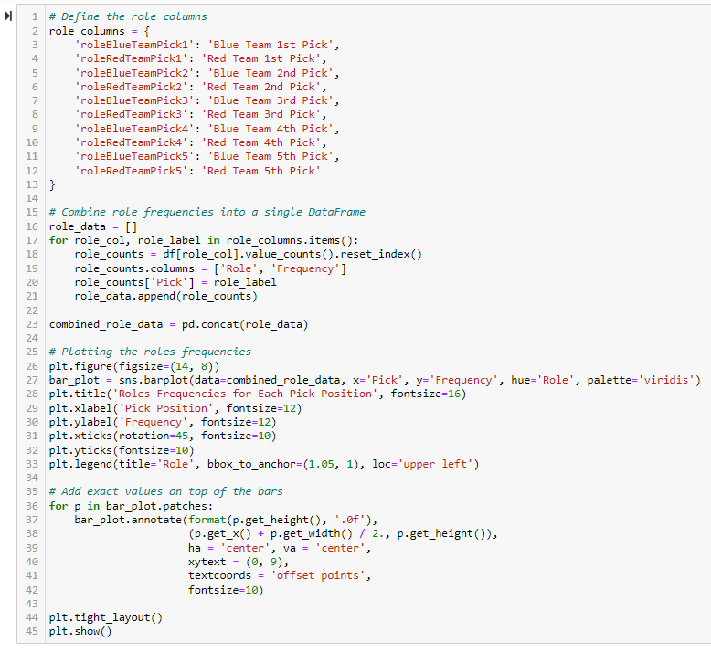
Part 2: Data Analysis and Data Visualization
Roles Frequency in Each Picks
Amirul Ikhwan Faizi
29

Slide 30
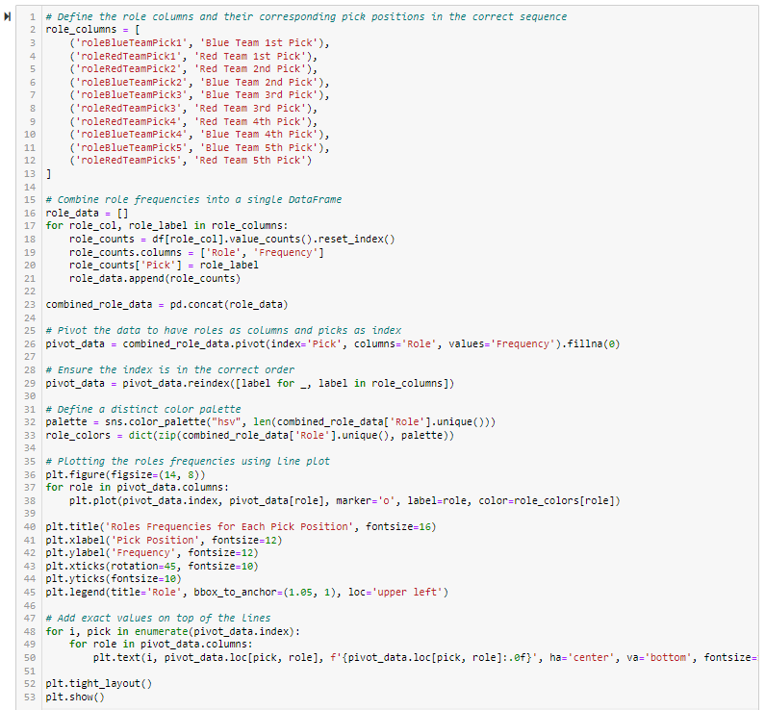
Part 2: Data Analysis and Data Visualization
Roles Frequency in Each Picks
Amirul Ikhwan Faizi
30

Slide 31
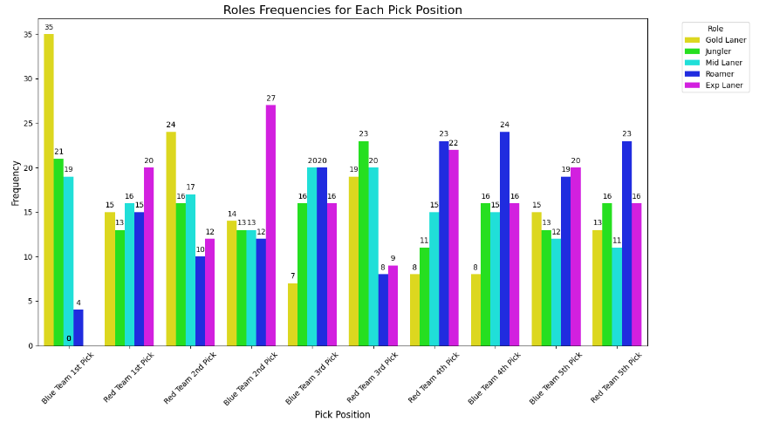
Part 2: Data Analysis and Data Visualization
Roles Frequency in Each Picks
This plot provides a detailed view of the role frequencies for each pick position, illustrating the strategies and preferences of the teams in the drafting phase. Here are some insights based on the data:
1. Gold Laner Dominance in Early Picks: The Gold Laner role is highly prioritized, especially in the first picks for both Blue and Red teams. This suggests that securing a strong Gold Laner is a key strategy, likely due to their importance in the early and mid-game phases.
Amirul Ikhwan Faizi
31

Slide 32
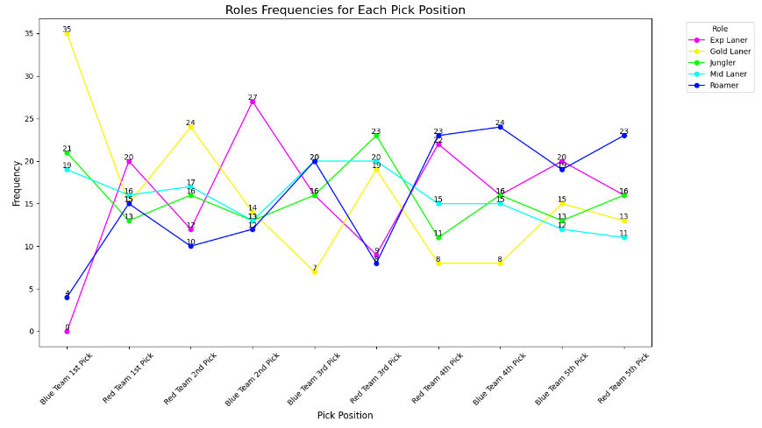
Part 2: Data Analysis and Data Visualization
Roles Frequency in Each Picks
2. Role Diversity in Mid-Picks: As the draft progresses to the second and third picks, the variety of roles picked becomes more balanced. This indicates that teams are focusing on building a well-rounded composition rather than securing specific roles early on.
Amirul Ikhwan Faizi
32

Slide 33
Part 2: Data Analysis and Data Visualization
Roles Frequency in Each Picks
3. Roamer and Exp Laner Importance in Later Picks: The Roamer and Exp Laner roles see significant picks in the fourth and fifth positions. This may imply that teams are looking to finalize their team composition with heroes that can influence the game dynamically in these roles.
4. Strategic Role Allocation: The consistent picking of Mid Laners and Junglers across various positions highlights their essential roles in the game. Teams seem to prioritize having a strong core by securing these roles throughout the drafting phase.
5. Team Strategies: The plot also shows how Blue and Red teams differ slightly in their drafting strategies. For instance, Blue Team's first pick is heavily skewed towards Gold Laner, while Red Team's first pick is more balanced between roles. This might reflect different strategic approaches or adaptations based on the opposing team's draft.
Amirul Ikhwan Faizi
33

Slide 34
I wish I can show more statistical point of view analysis and more usage of this data. But I want to stop in this point first to show what I can achieve for now. Too many slides I think. I may continue within this small project with many possible analysis, insight or maybe try to train this data for machine learning for example if I may have enough time.
For your reference:
https://github.com/IkhwanFaizi/MLBB_Draft
Thank You
Amirul Ikhwan Faizi

